Slide 1


A TASK OPTIMIZED NEURAL NETWORKS
Presented by
C.Vigneswaran 120003362 (IV-CSE)
G.Keerthi 120003143 (IV-CSE)
K.P.Bala vilasini 119015014 (IV-IT)
Supervisor
Prof. V. S. Shankar Sriram
Associate Dean - CSE
School of Computing
SASTRA Deemed University
Aug 20, 2019
8/21/2019
1
1
Notes:
1

Slide 2
QUICK ENTHRALLING FACTS
Recently Scientific American reported, the world’s biggest “brain” SpiNNaker: a supercomputer with a million processing cores and 1,200 interconnected circuit boards that together operate like a human brain.
Ten years in the making, it is the world’s largest neuromorphic computer—a type of computer that mimics the firing of neurons
SpiNNaker doesn’t just “think” like a brain. It creates models of the neurons in human brains, and it simulates more neurons in real time than any other computer on Earth
Its primary task is to support partial brain models: for example, models of cortex, of basal ganglia, or multiple regions expressed typically as networks of spiking [or firing] neurons

Slide 3
What we achieved?
Even with a million processors, we can only approach 1 percent of the scale of the human brain, and that’s with a lot of simplifying assumptions
If a mouse thinks mouse-sized thoughts and all that is required is enough neurons wired together in the right structure (which is itself a debatable point), then maybe we can now reach that level of thinking in a model running on SpiNNaker

Slide 4
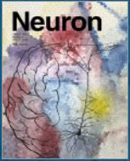
Base Paper
Title : A task-optimized neural network replicates human auditory behavior, predicts brain responses, and reveals a cortical processing hierarchy
Journal : Neuron
Publisher : Cell Press
Parent Organization : Elsevier
Impact Factor : 14.403
Indexing : SCI & SCI-E
Year, Volume, Page No. : 2018, 98, 630-644
DOI : doi.org/10.1016/j.neuron.2018.03.044
4

Slide 5
Abstract
Mimicking the Human Brain as Artificial Neural Networks to enhance the prediction and classification power of the learning model
A core goal of auditory neuroscience is to build quantitative models that predict cortical responses to natural sounds
Hierarchical neural networks for speech and music recognition has been designed
It is observed that the best-performing network contained separate music and speech pathways following early shared processing by replicating human cortical organization
The network performs the task and exhibited human-like errors, suggesting common constraints on both network and human performance
The network is also made to predict fMRI voxel responses and found to perform better than traditional spectro-temporal filter models
It also edify a quantitative representation of cortical hierarchy.
It provides a powerful set of tools for modeling sensory systems and paves way to better understand the inscrutable workings of Human Brain
5

Slide 6
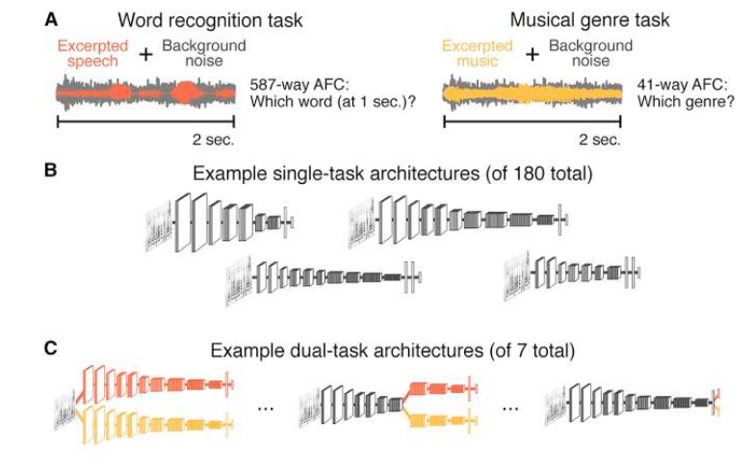
Experimentation

Slide 7
Data acquisition
Word & genre recognition psychophyiscs
For the word recognition psychophysics, eighteen subjects participated (12 female, mean age: 23 years, range: 18-33 years).
For the genre recognition psychophysics, experiments were performed both in-lab (n = 31; 20 female; mean age: 26 years, range: 19-43) and on Amazon’s Mechanical Turk (n = 80; 26 female; mean age: 34 years, range: 19-67).
All subjects had self-reported normal hearing, and provided informed consent.
fMRI cortical responses to natural sounds
Scanning sessions: Eight participants (four female, mean age: 22 years, range: 19-25; all right-handed) completed three scanning sessions (each 2 hours). Subjects were non-musicians (no formal training in the five years preceding the scan), native English speakers, and had self-reported normal hearing.

Slide 8
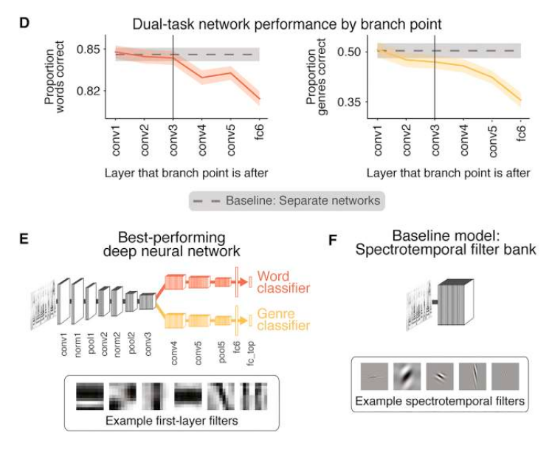
Observation - I

Slide 9
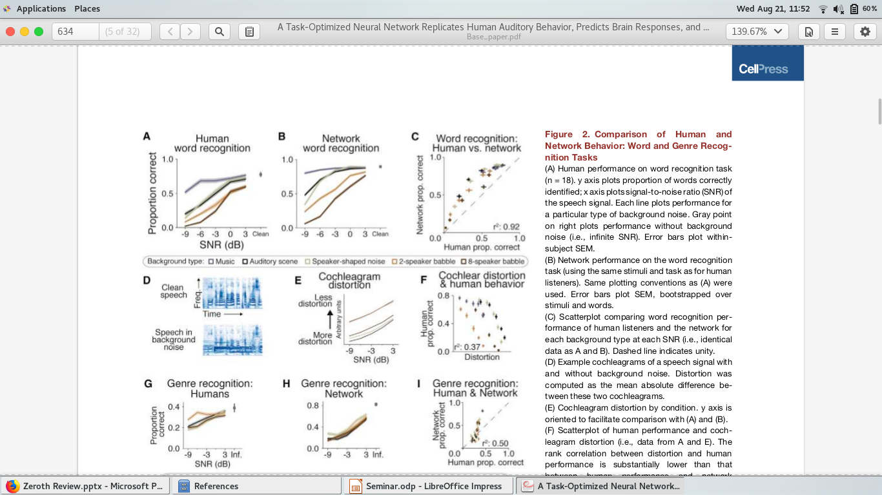
Observation - II

Slide 10
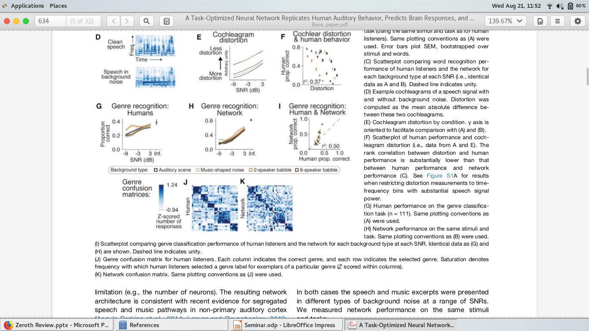
Observation - III

Slide 11
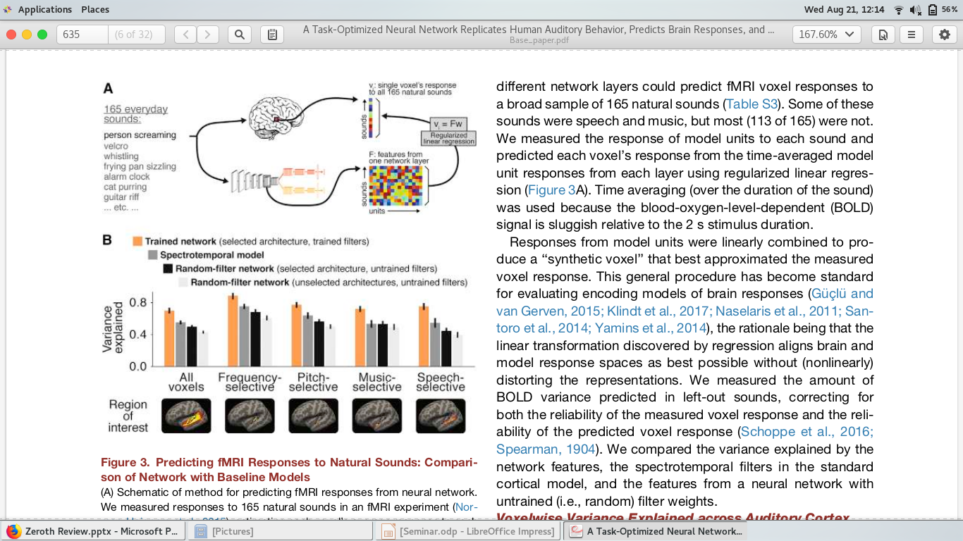
Observation - IV

Slide 12
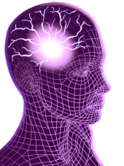
THANK YOU!!!

